Slide 1
Assignment 6: eco – Animal – ninja free home
Konrad Bartlett
0580964
2018 / 11 / 07

Slide 2
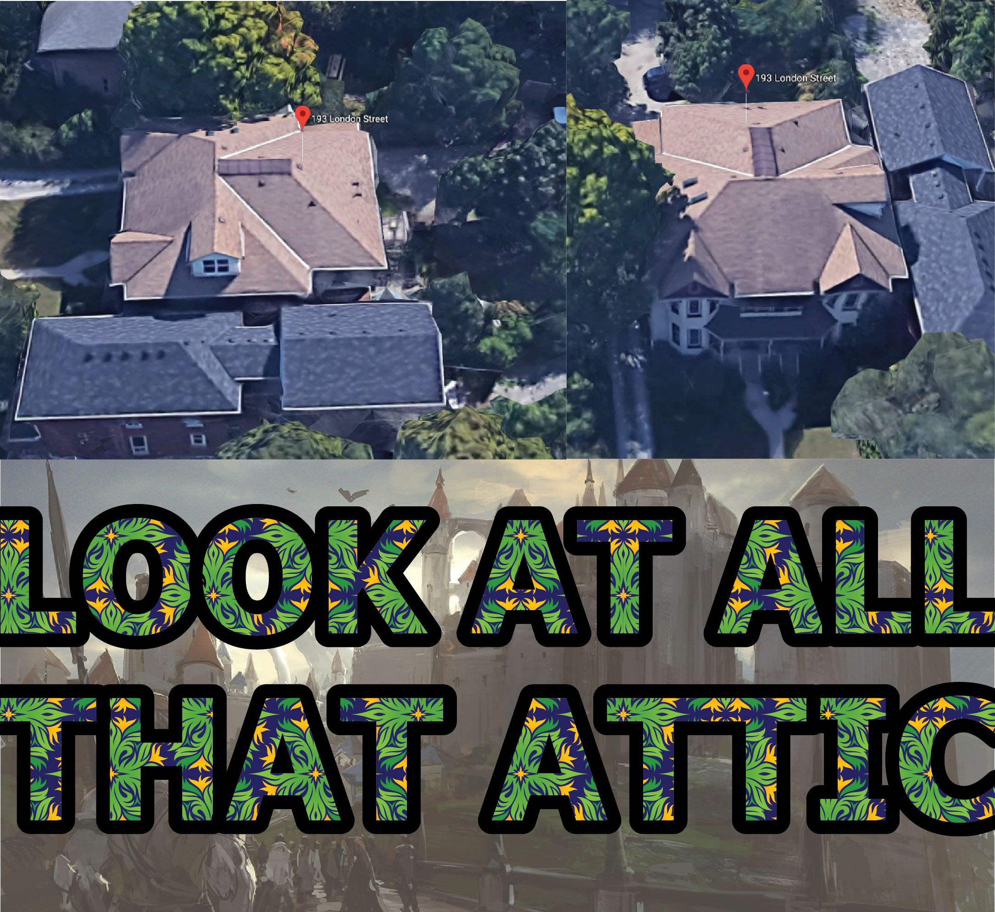
The issue at hand
I live in attic
The attic isn’t very well laid out
This results in a massive waste of space
This waste of space allows animals in walls
I hear them in my dreams

Slide 3
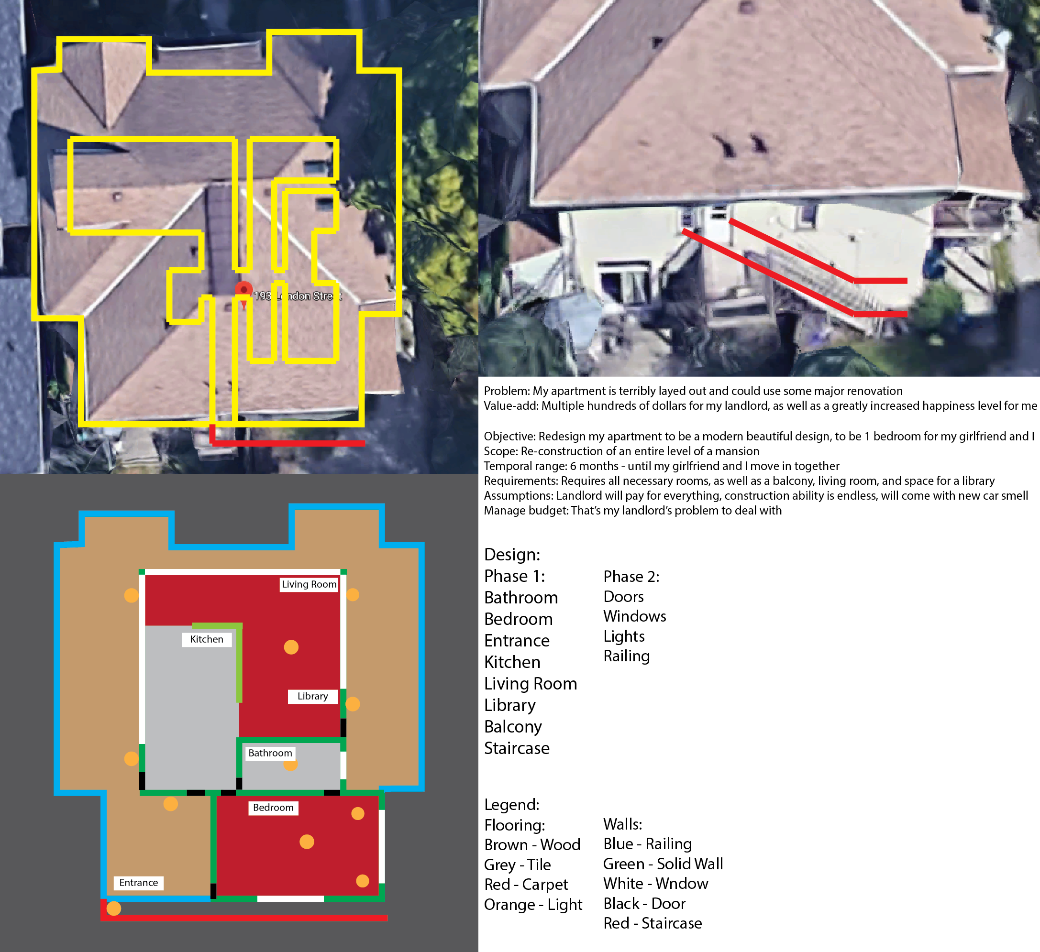
The solution
Completely remove the roof of building
Redo entire floor structure on-top of a
new foundation
New roof is solar panels
Walls are made from vegan materials
Glass is protesting air pollutants
Building is really trying hard to be
environmentally conscious

Slide 4
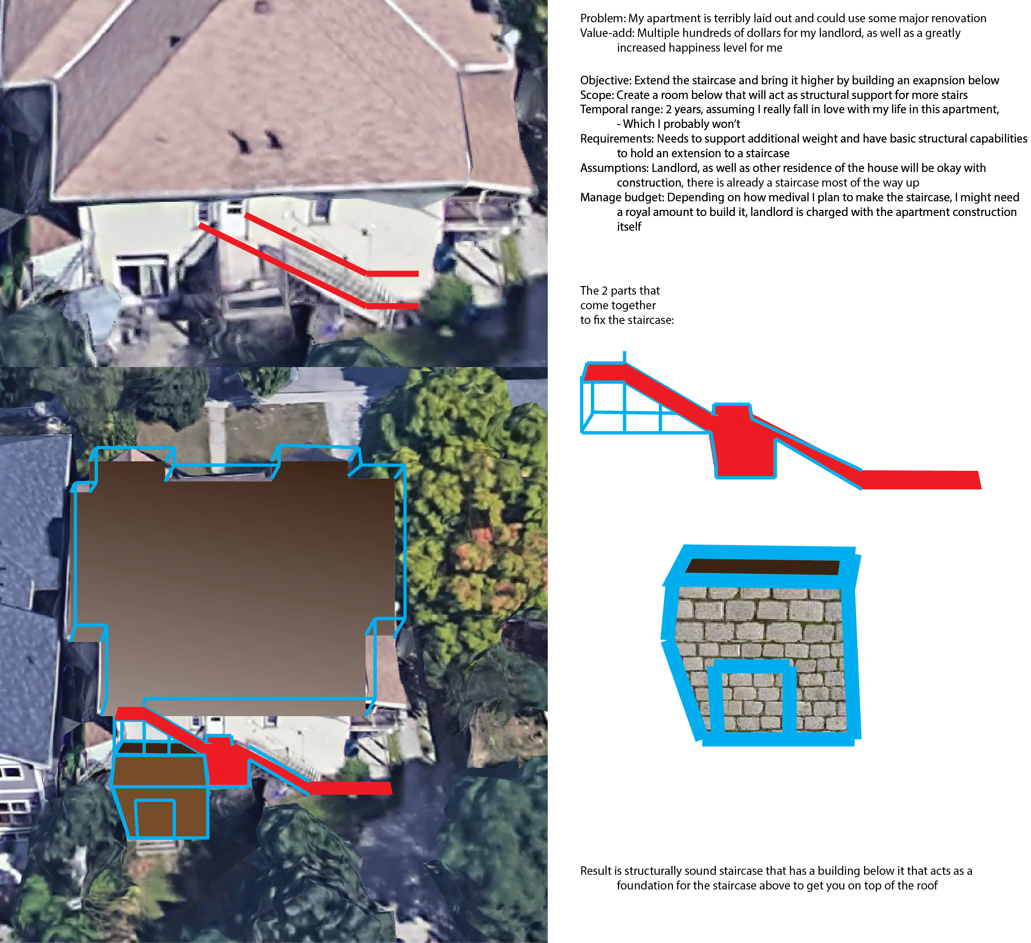
The solution *
The issue came up of how to get up to the
roof
The answer is simple, build higher
Added height makes it hard for ninjas to jump
The walls of support are wet slip ‘n’ slides
Support beams are 6’5” (wider than arm span)
Virtually ninja proof

Slide 5
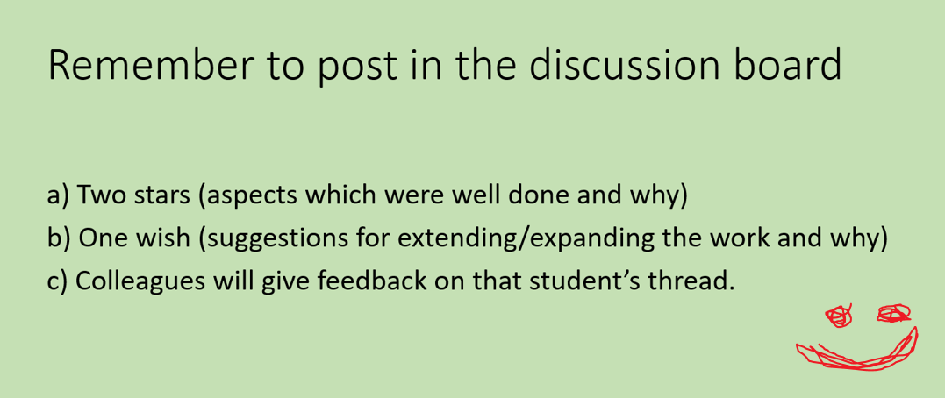
a

